Slide 1
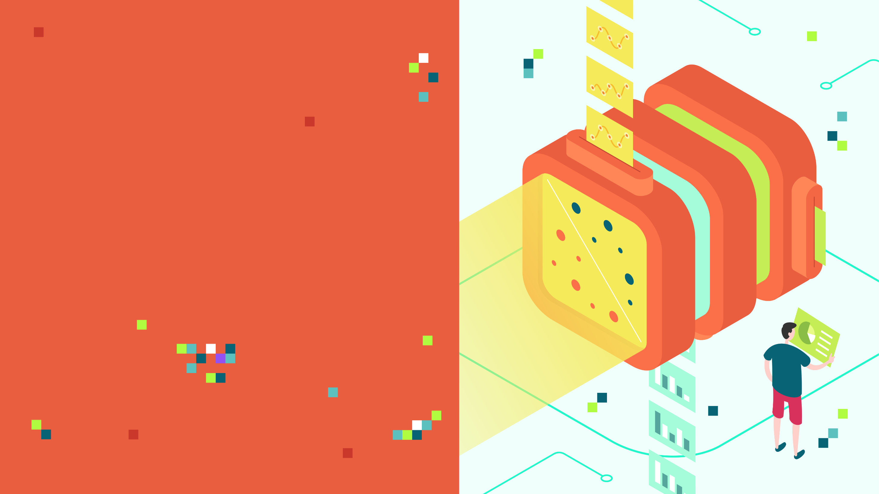
MACHINE LEARNING REGRESSION
BIAS VARIANCE TRADE-OFF
Notes:
Training & Testing vs real world data SCENARIO
Preparing student for exams – BECE, SSCE, As an instructor, you set 100 questions. If all the 100 questions are used to train the students and access them in mock, they would master these questions and your best students can “over fit” the process. However, there can be suprises in the final WAEC exams.
Ideally, you set 100 questions, split the questions in 75 question to students, and you hide the remaining 25 for future testing and evaluation in mock and accessment. You and solve the 75 questions with them in the preparation process, as preparations, and the 25, would be used to test their readiness for the main exams
Training Questions – 75 questions, instructor lead, go through all of these to train the students
Test Questions – 25 Questions, students have never seen before, use that in mock, to access how well the students are ready for the real exams from WAEC
Getting them ready for WAEC exams

Slide 2
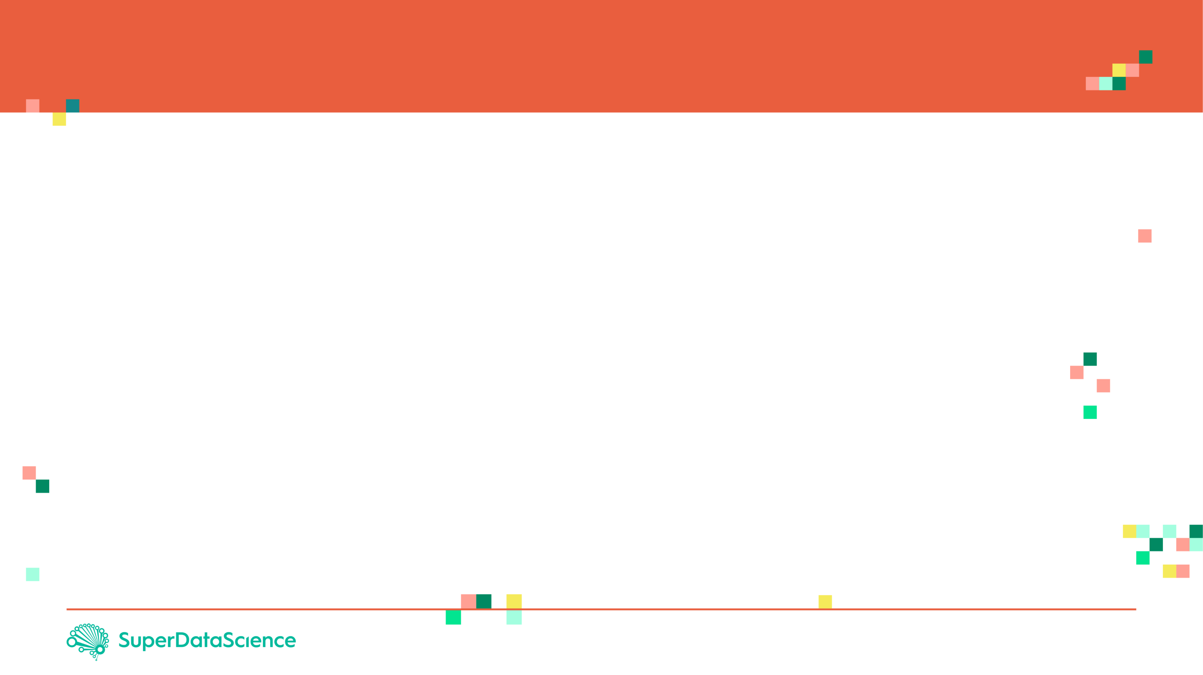
BIAS AND VARIANCE: INTUITION
Let’s assume that we want to get the relationship between the employee salary and number of years of experience
Fresh graduates tend to have low salaries
As years of experience increase, the salaries tend to increase as well.
As number of years go beyond a certain limit, salaries tend to plateau and they do not increase anymore
PERFECT (TRUE) MODEL!
SALARY
# YEARS OF EXPERIENCE

Slide 3
BIAS AND VARIANCE: TRAINING VS. TESTING DATASETS
Dataset is divided to training and testing datasets
Testing datasets have never been seen by the model before
SALARY
TESTING DATASET
TRAINING DATASET
# YEARS OF EXPERIENCE

Slide 4
BIAS AND VARIANCE: MODEL #1– LINEAR REGRESSION (SIMPLE)
Linear Regression model uses a straight line to fit the training dataset
Linear regression model lacks flexibility so it cannot properly fit the data (as the true perfect model does!)
The linear model has a large “bias” which indicates that the model is unable to accurately capture the true relationship between salary and # years of experience.
PERFECT (TRUE) MODEL!
SALARY
LINEAR REGRESSION MODEL
TRAINING DATASET
# YEARS OF EXPERIENCE
Notes:
We can bend linear regression to properly fit the training data
Linear regression is not flexible – Large Bias

Slide 5
BIAS AND VARIANCE: MODEL #2 – HIGH ORDER POLYNOMIAL REGRESSION (COMPLEX)
PERFECT (TRUE) MODEL!
High order polynomial model is able to have a very small bias and can perfectly fit the training dataset.
High-order polynomial model is very flexible
SALARY
HIGH ORDER POLYNOMIAL MODEL
TRAINING DATASET
# YEARS OF EXPERIENCE
Notes:
Has small bias and fits the model perfitly

Slide 6


BIAS AND VARIANCE: MODEL #1 Vs. MODEL #2 DURING TRAINING
PERFECT (TRUE) MODEL!
PERFECT (TRUE) MODEL!
SALARY
SALARY
LINEAR REGRESSION MODEL
HIGH ORDER POLYNOMIAL MODEL
# YEARS OF EXPERIENCE
# YEARS OF EXPERIENCE
SUM OF SQUARES (LARGE)
SUM OF SQUARES (SMALL ~0)
THIS IS NOT THE WHOLE STORY!!

Slide 7
BIAS AND VARIANCE: MODEL #1 Vs. MODEL #2 DURING TESTING
PERFECT (TRUE) MODEL!
PERFECT (TRUE) MODEL!
SALARY
SALARY
LINEAR REGRESSION MODEL
HIGH ORDER POLYNOMIAL MODEL
# YEARS OF EXPERIENCE
# YEARS OF EXPERIENCE
SUM OF SQUARES (SMALL)
SUM OF SQUARES (LARGE)
The polynomial model performs poorly on the testing dataset and therefore it has large variance
Notes:
Higher order polynomial regression models works poorly on the test

Slide 8
MODEL COMPLEXITY VS. ERROR
Large Bias
Large
Variance
OPTIMUM MODEL
Regularization works by reducing the variance at the cost of adding some bias to the model.
A trade-off between variance and bias occurs
TOTAL ERROR
VARIANCE
ERROR
Optimal Model
Small
Variance
Small Bias
BIAS
MODEL COMPLEXITY
LINEAR
POLYNOMIAL
Less Complex Models
Eg. Simple Linear
More Complex Models
Eg. Neuron Models
Notes:
Small Variance – The performance during training will match the performance during testing
Large Variance – The model overfits

Slide 9
MODEL COMPLEXITY VS. ERROR
MODEL #1 (LINEAR REGRESSION) (SIMPLE) | MODEL #2 (HIGH ORDER POLYNOMIAL) (COMPLEX)
Model has High bias because it is very rigid (not flexible) and cannot fit the training dataset well | Model has small bias because it is flexible and can fit the training dataset very well.
Has small variance (variability) because it can fit the training data and the testing data with similar level (the model is able to generalize better) and avoids overfitting | Has large variance (variability) because the model over fitted the training dataset and it performs poorly on the testing dataset
Performance is consistent between the training dataset and the testing dataset | Performance varies greatly between the training dataset and the testing dataset (high variability)
Good generalization | Over fitted
Variance measures the difference in fits between the training dataset and the testing dataset
If the model generalizes better, the model has small variance which means the model performance is consistent among the training and testing datasets
If the model over fits the training dataset, the model has large variance
PERFECT REGRESSION MODEL SHALL HAVE SMALL BIAS AND SMALL VARIABILITY!
A TRADEOFF BETWEEN THE BIAS AND VARIANCE SHALL BE PERFORMED FOR ULTIMATE RESULTS

